Slide 1

4-umpire mechanics

Slide 2
The objectives of
4-umpire mechanics
Have an umpire at every base or close to every play
Try to keep one umpire AHEAD of the lead runner
If possible, “box” the runner between three umpires

Slide 3
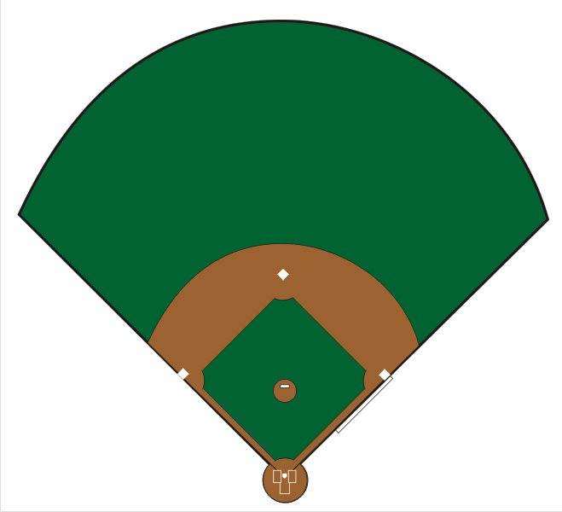
Field Umpire
Positions
E
E
F
C
B
D
A
D
A
Notes:
DEEP A
Used by U1 with no runner on 1st
SHALLOW A
Used by U1 with a runner on 1st
DEEP B
Used by U2 with a runner on 2nd
DEEP C
Used by U2 with a runner on 1st, but not on 2nd
DEEP D
Used by U3 with no runner on 3rd
SHALLOW D
Used by U3 with a runner on 3rd
E
Used by U2 with no runner on 1st or 2nd
Generally, batters are “pull” hitters. Be on the Left field side for right handed hitters and Right field side for left-handed hitters
F
OPTIONAL – can be used by U2 with a runner on 2nd only or 2nd and 3rd

Slide 4
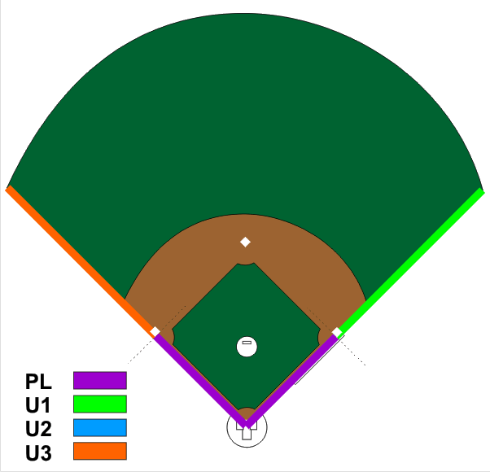




Fair / Foul
Coverage
Notes:
PL has responsibility up to the front edge of first/third base
U1 has responsibility from the front edge of first base to the fence
U3 has responsibility from the front edge of third base to the fence

Slide 5
Fly Ball Coverage
Someone goes out on
EVERY fly ball
Notes:
Someone goes out on ALL fly balls – even the “cans of corn”
The coaches are paying for FOUR umpires and they EXPECT to have someone out there……..just in case

Slide 6
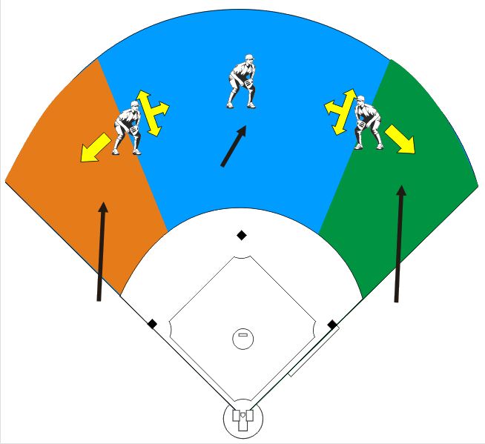
Fly Ball Coverage
U2 is OUT
(in E or F)
Notes:
With U2 in the outfield or in “F”
PL has NO fly ball responsibility
U1 has the right fielder moving toward the foul line
U2 has center field, the left or right fielder moving straight forward/backward or toward center field
U3 has the left fielder moving toward the foul line
U2 is the “KEY” to rotation
If U2 goes out, it is his call……even if he is wrong, he is RIGHT
If U2 does NOT go out, either U1 or U3 must go out to rule on the play
If ANY umpire “goes out”, coverage reverts to 3-umpire mechanics

Slide 7
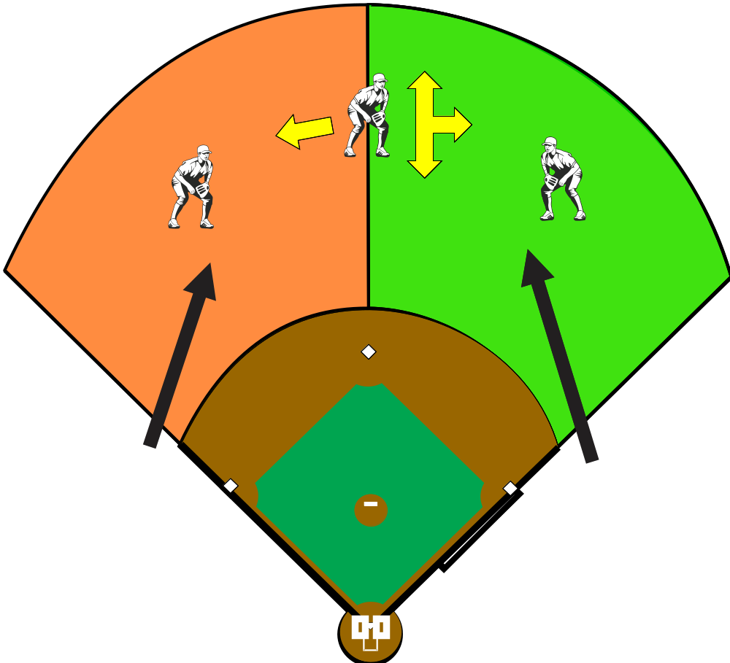
Fly Ball Coverage
U2 is IN
(in B or C)
Same coverage
used in 3-Umpire
Mechanics
Notes:
If U2 is “inside”
Coverage is the same as in 3-umpire mechanics
PL and U2 have no fly ball responsibility in the outfield
U1 has right field and the center fielder moving straight forward or backward or toward right field
U3 has left field and the center fielder moving toward left field
If U1 or U3 “goes out”, coverage reverts to 3-umpire mechanics

Slide 8
Fly Ball Coverage
When U2 is inside (in B or C)
He STAYS inside
U2 does NOT go out for a fly ball, leave that to U1 and U3
Notes:
When U2 is “inside”….he STAYS inside
U2 has no fly ball responsibility and does not “cross the dirt” to rule on a fly ball in the outfield
This is different for those who might be calling college games using NCAA/CCA mechanics

Slide 9
U2 is the “KEY”
for rotation when U2 is OUT
Notes:
If U2 is “outside” (“E” or “F”)
U2 is the “KEY” to fly ball coverage
If U2 goes out……it is his call
Even if he is wrong……he is RIGHT
Don’t have more than one umpire out on a fly ball

Slide 10
Just like
3-Umpire
Mechanics
U1 is the “KEY”
for rotation when U2 is IN
(B or C)
Notes:
If U2 is “inside” (“B” or “C”)
Fly ball coverage is the same as in 3-umpire
U3 is the KEY to coverage

Slide 11
If ANY umpire goes out
on a fly ball………
Revert to
THREE-UMPIRE Mechanics
Notes:
If U2 is “inside”
If U1 or U3 “goes out”
Coverage reverts to 3-umpire mechancis

Slide 12
If you GO OUT
You STAY OUT
Notes:
If you go out…….STAY OUT
Stay in the outfield and observe playing action in case the crew needs to get together to rule on a play

Slide 13
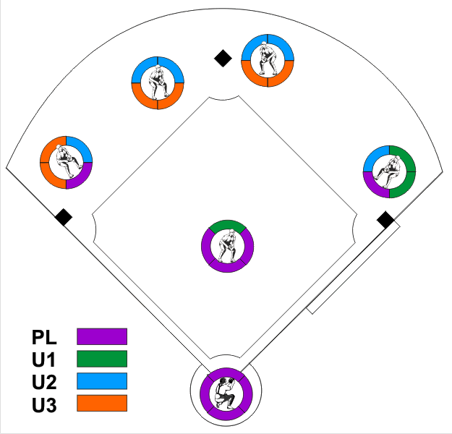
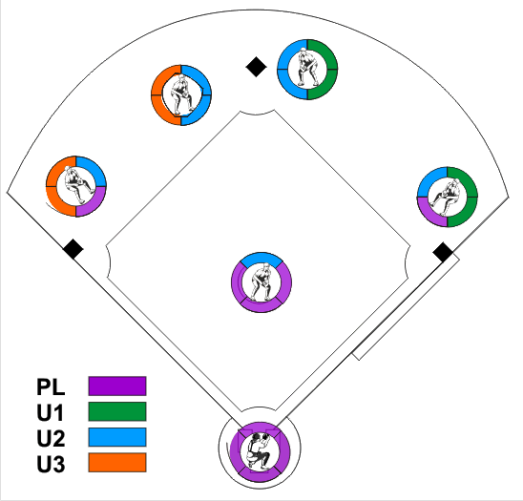
INFIELD
Catch / No Catch Responsibilities
U2 is OUT
(in either E or F)
U2 is IN
Notes:
This is not as complicated as it looks
Who has the best look at the play? Let him make the call

Slide 14
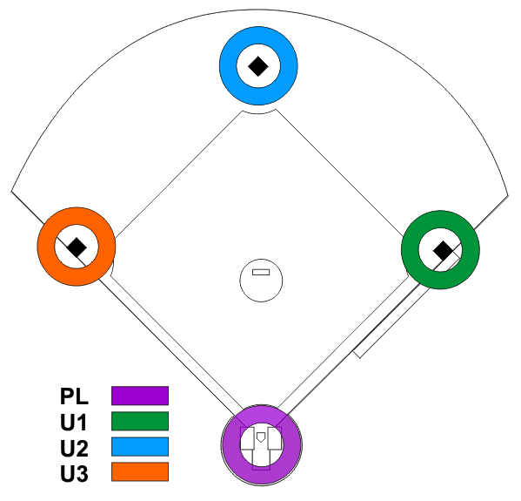
Tagups and Touches
Base Hit / Infield Hit
Notes:
With U2 “inside” and no umpire “goes out”
U1 has tags and touches at 1st
U2 has tags/touches at 2nd
U3 has tags/touches at 3rd
PL has tags/touches at the plate

Slide 15
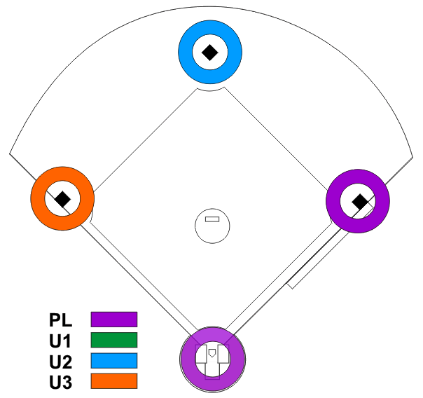
Tagups and Touches
U1 Goes Out
U2 is OUT
Notes:
U2 is “outside” and U1 “goes out”
PL now has tags/touches at 1st
U2 is coming into the infield from “E” and is too far away to make those calls
U1 goes out, he PULLS PL to first base responsibility, because U2 is being pulled in

Slide 16

Tagups and Touches
U1 Goes Out
U2 is IN
Notes:
U2 is “inside” and U1 “goes out”
Now U2 gets the tags/touches at 1st since he is already in the infield

Slide 17
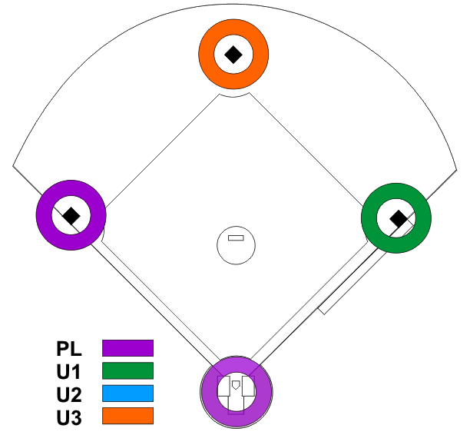
Tagups and Touches
U2 Goes Out
Notes:
U2 is “outside”, and U2 “goes out
U3 gets responsibility for 2nd
PL gets responsibility for 3rd

Slide 18
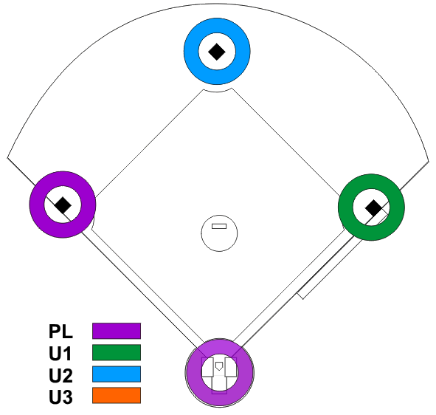
Tagups and Touches
U3 Goes Out
(regardless of whether
U2 is “In” or “Out”)
Notes:
U2 is either “inside” OR “outside” and U3 “goes out”
PL get the responsibility for 3rd

Slide 19
CHECK SWINGS
Go to the “Open” umpire
  U1 for RIGHT handed batters
  U3 for LEFT handed batters
Notes:
Check swings
U1 (at 1st) for RIGHT handed batters
U3 (at 3rd) for LEFT handed batters

Slide 20
Umpire Rotations
No Rotations on a
Base Hit
or
Infield Hit

Slide 21
Umpire Rotations
If ANY umpire goes out
on a fly ball………
Revert to
THREE-UMPIRE Mechanics
Notes:
If U2 is “inside”
If U1 or U3 “goes out”
Coverage reverts to 3-umpire mechancis

Slide 22
E
Umpire Positions
NO Runners

Slide 23


No Runners
U1 goes OUT

Slide 24
No Runners
U2 goes OUT

Slide 25
No Runners
U3 goes OUT

Slide 26
No Runners
Base Hit

Slide 27
No Runners
Hit to Infield

Slide 28

Runner on First
Umpire Positions

Slide 29
Runner on 1st
U1 goes OUT

Slide 30
Runner on 1st
U3 goes OUT

Slide 31
Runner on Second
Umpire Positions

Slide 32
Runner on Second
U2 in “B”
U1 Goes Out

Slide 33
Runner on Second
U2 in “B”
U3 Goes Out

Slide 34

With a Runner on 3rd only,
U2 should ALWAYS be on
The 3rd base side of the field
in Position F
Runner on Third
Umpire Positions

Slide 35
And here’s why….

Slide 36
Runner on Third
Fly Ball to
Shallow Left Field
U3’s responsibility
less than 2 outs

Slide 37
Runner on Third
U1 Goes Out

Slide 38
Runner on Third
U2 Goes Out

Slide 39
Runner on Third
U3 Goes Out

Slide 40
Runners on
1st and 2nd
Umpire Positions

Slide 41
Runners on
1st and 2nd
U1 Goes Out

Slide 42
Runners on
1st and 2nd
U3 Goes Out

Slide 43
Runners on
1st and 3rd
Umpire Positions

Slide 44
Runners on
1st and 3rd
U1 Goes Out

Slide 45
Runners on
1st and 3rd
U3 Goes Out

Slide 46
Runners on
2nd and 3rd
Umpire Positions

Slide 47
Runners on
2nd and 3rd
U1 Goes Out

Slide 48
Runners on
2nd and 3rd
U3 Goes Out

Slide 49
Bases Loaded
Umpire Positions

Slide 50
Bases Loaded
U1 Goes Out

Slide 51
Bases Loaded
U3 Goes Out

Slide 52
Rundowns
If all Umpires are “IN”
  Umpires assigned to the bases involved handle the rundown
If any Umpire is “OUT”
  Use Rundown Mechanics for 3-Umpires

Slide 53
No Matter What Happens…..or
Who misses a rotation
FILL THE HOLE !!!
We can talk about missed
coverage later……….but
SOMEONE has to MAKE THE CALL

Slide 54
4-umpire mechanics

